Slide 1
Retinal Analysis Using Deep Retina for Diabetic Retinopathy Classification and Detection
TITLE:

Slide 2
CONTENTS
. Introduction
Problem Statement
Objective and Scope
Related Work
Methodology
Results
Conclusion and Future scope

Slide 3
INTRODUCTION
One of the main causes of blindness worldwide, diabetic retinopathy (DR), is extremely common; within 20 years of diagnosis, 80% of diabetic people will acquire DR.
Timely and precise intervention is essential to reduce sight-threatening consequences; therapies may include intravitreal injections of anti-vascular endothelial growth factor, steroids, or laser therapy.
The efficacy of these interventions depends on early detection of the disease's progression to a stage where action is required.
Since classifications usually rely on professional clinical interpretation, the subjective character of DR severity categorization and early diagnosis typically introduces variability.
In this work, we present a thorough end-to-end deep convolutional neural network method intended for the automated diagnosis of diabetic retinopathy.
The determination of referable status, with a focus on more severe cases such as severe non-proliferative DR.

Slide 4
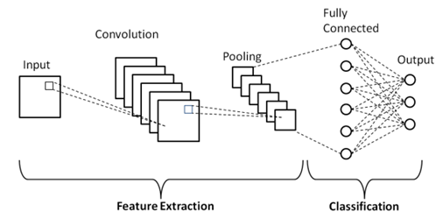
1. Our results demonstrate not only the provided model's viability but also its improved performance over conventional machine learning techniques. The present study provides significant contributions to the advancement of automated DR detection and classification.
Fig1: Convolutional neural networks

Slide 5
PROBLEM STATEMENT
The problem is to accurately detect and classify areas with diabetic retinopathy in retinal images from diabetic patients, which requires image processing techniques.
Diabetic Retinopathy (DR) is a leading cause of vision loss among diabetic patients worldwide. Early detection and timely intervention are crucial to preventing blindness. However, current diagnosis methods rely on manual screening by ophthalmologists, which is:
Time-consuming
Expensive
Not accessible to all patients, especially in rural areas
Current pre-trained models like ResNet-18, DenseNet121, and EfficientNetB0 often require substantial computational resources, making it necessary to find a more efficient model that performs well without demanding excessive processing power.

Slide 6
OBJECTIVE
1. Assess the model's efficacy in identifying diabetic retinopathy by comparing it to existing techniques and measuring accuracy, sensitivity, and specificity.
2. Examine the model's flexibility and stability in relation to different retinal slabs and picture sizes in order to maximize the diagnostic procedure.
3. Explore how adding OCTA data to the deep learning model can improve its specificity and accuracy while offering more information about the retinal microvasculature and better diagnostic tools.
4. Uses light waves (instead of dye injection) to create detailed 3D images of retinal blood vessels.
Can detect tiny blood vessel changes (blockages, leakage, new vessel growth). Helps identify DR severity before visible symptoms appear in fundus photography.

Slide 7
Related Work
The financial consequences of managing diabetes are a major public health concern, and healthcare policy and resource allocation depend heavily on this knowledge.
Technical specifics would include the utilization of datasets like the Medical Expenditure Panel Survey and the inclusion standards for choosing the research subjects.
Determining healthcare utilization trends, direct medical expenditures, and variables impacting changes in spending during the years under study are probably all part of the analysis.
The procedures used to train and validate the deep learning algorithm are described in the methodology section.
To improve the algorithm's capacity to generalize across different diabetic retinopathy presentations, it was trained on a wide range of pictures.

Slide 8
ResNet 18 (Residual Network):
1. ResNet (Residual Network) is a deep learning architecture introduced by Microsoft Research in the paper “Deep Residual Learning for Image Recognition” (2015).
2. ResNet introduces skip connections, which allow the network to learn residual mappings instead of direct mappings.
3. A well-known deep convolutional neural network architecture known for its depth and creative use of residual connections is called ResNet18, or Residual Network with 18 layers.
4. ResNet18 stands out for its capacity to effectively train deep networks, even in the face of obstacles like the vanishing gradient problem. With 18 layers, the network has an outstanding depth, denoted by the number "18."
5. Renowned for its extraordinary precision, ResNet18 finds wide use in picture classification applications and performs exceptionally well across a range of computer vision areas.
6. ResNet18 is a medical image processing tool that has been used to classify diabetic retinopathy and other conditions by taking use of its ability to recognise complex patterns and characteristics in images.

Slide 9
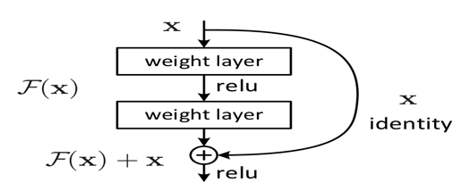
Fig 2 : ResNet18
1. Traditional deep networks face difficulty in training due to vanishing gradients, which make weight updates ineffective. ResNet introduces skip connections, which allow the network to learn residual mappings instead of direct mappings. This helps in training very deep networks effectively.
y=F(x)+x
Where:
x = Input
F(x) = Transformation through convolutional layers
y = Output after summing the input and transformation

Slide 10
Advantages of ResNet-18:
1. Solves Vanishing Gradient Problem – Residual connections allow deeper networks to train effectively.
2. Efficient Training – Allows deep networks to converge faster with fewer computational resources.
Disadvantages of ResNet-18:
1. More Computational Overhead – Although efficient, ResNet still requires more computation compared to shallower networks.
2. More Parameters than Basic CNNs – Even though it's smaller than ResNet-50 or ResNet-101, it still has more parameters than simpler architectures like AlexNet.
3. Difficult to Debug – If the model is not converging well, debugging which part of the architecture is causing the issue is harder compared to simpler architectures.

Slide 11
DenseNet121:
DenseNet (Densely Connected Convolutional Network) was introduced in the paper “Densely Connected Convolutional Networks” by Gao Huang et al. (2017).
Unlike traditional CNNs and ResNet, DenseNet connects each layer directly to every other layer in a feed-forward manner.
An important tool in the context of the endeavour in concern is DenseNet121, an extension of the DenseNet121 architecture created especially for embedded and mobile vision applications.
Because of its efficient and lightweight architecture, DenseNet121 is especially useful for mobile devices that operate in contexts with limited resources.
Especially in healthcare applications, its efficiency is critical for real-time photo analysis.Battery life preservation and reduced computational load are made possible by DenseNet121's lightweight design, which is a crucial component for embedded and mobile systems.
DenseNet121 is a logical candidate for implementing AI-driven diagnostic tools in the medical area because of its versatility and resource-friendly nature, particularly in the project's focus on diabetic retinopathy classification. It reuses features from earlier layers.

Slide 12
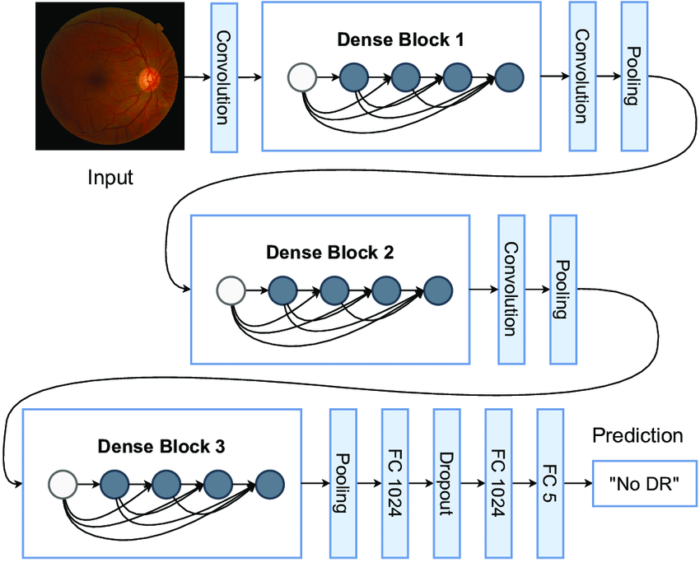
Fig 3 : Desnet-121
* Each layer performs: x l​=H l([x 0,x 1 ,...,xl−1])
Where:
x_{l} = Output of layer l
H₁ = Transformation (BatchNorm ReLUConvolution)
[X0, X1, ..., XI-1] = Concatenation of feature maps from previous layers

Slide 13
Advantages of DenseNet-121:
1. Efficient Feature Reuse – Each layer gets inputs from all previous layers, reducing redundancy and improving learning.
2. Fewer Parameters than ResNet – Due to feature reuse, DenseNet is more parameter-efficient compared to ResNet of similar depth.
3. Better Gradient Flow – Since each layer is directly connected to earlier layers, gradients flow better during backpropagation, reducing vanishing gradient issues.
Disadvantages of DenseNet-121:
1. Higher Memory Usage – Since every layer is connected to all previous layers, it requires more GPU memory.
2. Computationally Expensive – Concatenating feature maps at each step increases computation time, making it slower compared to simpler architectures.
3. Difficult to Implement on Edge Devices – Due to memory and computation constraints, DenseNet is challenging to deploy on mobile or IoT devices.

Slide 14
EfficientNetB0:
1. EfficientNet-B0 is a convolutional neural network (CNN) developed by Google in 2019. Within the family of Efficient Net models is the convolutional neural network architecture known as EfficientNetB0.
2. It has become well-known for its abilities in picture classification and feature extraction, among other computer vision applications.
3. The architecture is made to maximize computational resources by balancing the model's width, depth, and resolution. For deployment in situations where resources are few, like embedded systems or mobile devices, EfficientNetB0 is especially well-suited.
4. Because of its precision and efficiency, EfficientNetB0 is a useful tool when it comes to medical imaging duties.
5. It could help with activities where real-time processing and resource optimisation are essential, such as brain tumour diagnosis or diabetic retinopathy categorization.

Slide 15
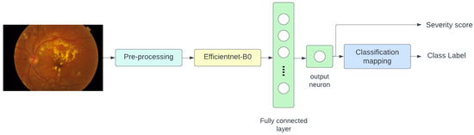
Fig 4 : Efficientnet-B0
* EfficientNet introduces compound scaling, which balances three important factors:
Depth (D) → Number of layers
Width(W) → Number of channels in each layer
Resolution (R) → Size of input images

Slide 16
Advantages of EfficientNet-B0:
Higher Accuracy with Fewer Parameters – Outperforms ResNet and DenseNet while using far fewer parameters.
Optimized Scaling – Unlike ResNet, which simply increases depth, EfficientNet balances depth, width, and resolution efficiently.
Fast Inference – Due to its lightweight nature, EfficientNet-B0 is faster than deeper CNNs like ResNet-50 or DenseNet-121.
Uses compound scaling to balance model size and efficiency.
Disadvantages of EfficientNet-B0:
Not Always the Best for Small Datasets – If the dataset is small, simpler models like MobileNet may perform equally well with fewer computations.

Slide 17
Methodology
1. An emphasis on speed, precision, and real-time processing characterises the suggested method for identifying and managing diabetic retinopathy in retinal pictures.
2. First, it makes use of the EfficientNetB0 model, which is well known for its remarkable accuracy and economical use of memory. In situations where processing resources are scarce, such embedded systems and mobile devices, this option is especially beneficial because it meets the demand for quick and resource-efficient medical picture analysis.
3. In order to improve the model's resilience and make the most of the available training data, the method makes use of ImageDataGenerator for data augmentation. By applying random modifications to training images, this method enhances the generalisation capabilities of the model.

Slide 18
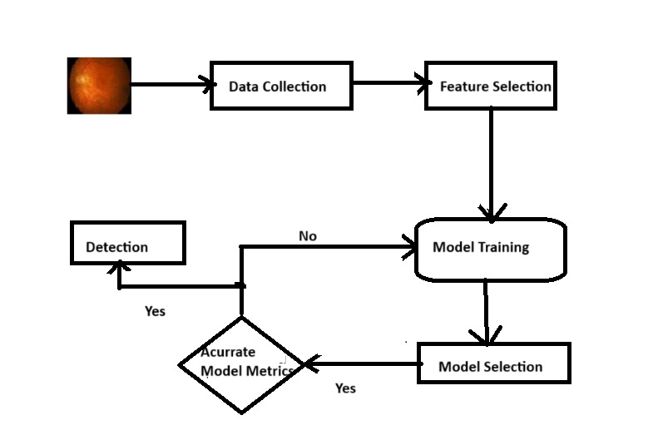
Fig5: Architecture

Slide 19
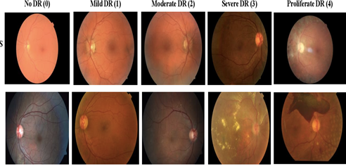
Dataset Collection:
1. The endeavor's dataset is a sizable collection of high-resolution retinal photographs taken under various imaging settings. Both the left and right eye fields are used to represent each subject, and the photos are labelled with the subject ID and the eye side (e.g., 1_left.jpeg corresponds to the left eye of patient ID 1).
2. The clinicians' assessments, which evaluate each image for the presence of diabetic retinopathy (DR) on a scale from 0 to 4, are the most important component of this collection. 0 represents no DR, 1 indicates mild DR, 2 indicates moderate DR, 3 indicates severe DR, and 4 indicates proliferative DR.
Fig6: DataSet

Slide 20
1. Data Preparation:
Compile an image dataset of DR scans and the labels that correspond to the presence or absence of DR. Make that the data covers a range of tumor kinds, patient demographics, and imaging conditions and that it is representative of the target population.
2. Preprocessing:
Before using medical pictures in a machine learning framework for the categorization of diabetic retinopathy (DR), preprocessing is essential to improving their quality and relevance.
3. Bilateral Filtering:
In order to reduce noise in the retinal pictures while maintaining important details and edges, bilateral filtering is used. In medical imaging, noise reduction is particularly important for precise diabetic retinopathy diagnosis and analysis.

Slide 21
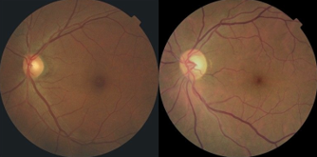
Resize:
Consistency in data dimensions is necessary for efficient input into a deep learning model for the classification of diabetic retinopathy.
In order to enable efficient processing within deep learning frameworks, the resizing stage resizes the retinal images to a standard size, such as 128x128 pixels. Illustrate how important this uniformity in image dimensions is for training and optimising the model's performance.
Fig: Before Fig: After

Slide 22
Model Training
1. Among computer vision techniques, using pre-trained deep convolutional neural network models is a common and successful approach, especially when it comes to classifying diabetic retinopathy (DR).
2. Usually, a wide variety of images and object categories are provided to these models during their pre-training phase using extensive benchmark datasets such as ImageNet.
3. Using pre-trained models has the benefit of saving a great deal of time and computational power compared to training a new model from scratch. This approach, which is also known as "transfer learning," uses well-known models like ResNet50, EfficientNetB0, as a basis for a fresh computer vision job.
4. Custom layers are usually added to a pre-trained model to customize it for a particular use case. The task-specific features are learned by these custom layers.

Slide 23
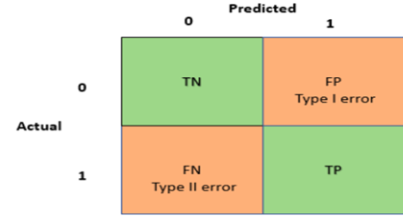
RESULTS
Evaluation and Metrics:
1. A classifier's standard evaluation is based on a number of predefined performance indicators. Our models are assessed using the following metrics: Accuracy, Specificity, F-score, Precision, and Recall.
2. First, we used a confusion matrix and made inferences from it for the classification algorithms. A confusion matrix is a table that, given a set of test data for which the real values are known, provides details on the quality or performance of a model for two or more types of classes. The simplest confusion matrix for the classifier 2 class, is a two-dimensional confusion matrix.

Slide 24
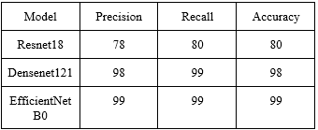
Accuracy:
One metric used to describe the framework's overall success in all classes is correctness. The computation involves dividing the total number of anticipates by the number of correct projections.
Precision:
The ratio of the total number of positive anticipates to the actual number of successes is known as precision. It asks what proportion of the optimistic projections turned out to be accurate.
Recall:
It is the proportion of actual positive results to the sum of false negative results and true positive results. It answers the query, "What percentage of actual positives were identified correctly?"

Slide 25
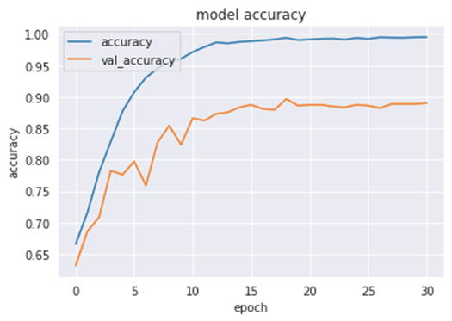
Fig7: Model Accuracy

Slide 26
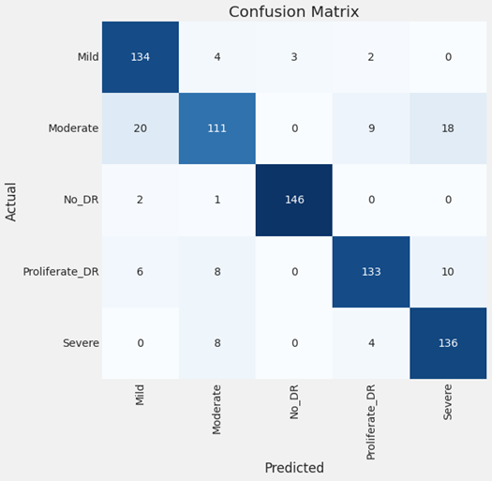
Fig8: Confusion Matrix

Slide 27
CONCLUSION
1. In conclusion, the experiment that was shown shows how well deep learning models more especially, EfficientNetB0, ResNet18, and DenseNet12 work when it comes to classifying diabetic retinopathy in images of the retinal fundus.
2. The models display excellent accuracy percentages; EfficientNetB0 leads the pack with an astounding 99.39%. The models' strong performance is a result of the use of pre-trained models, transfer learning, and careful consideration of data augmentation.
3. The use of EfficientNetB0, which is renowned for its accuracy and efficiency, makes it stand out as a potent instrument for the real-time identification of diabetic retinopathy, in line with the rising demand for precise and efficient medical solutions.
4. This will lay the groundwork for future developments in medical image analysis and support continuous efforts to improve healthcare diagnostics.

Slide 28
FUTURE SCOPE
1. The initiative's future scope encompasses multiple promising directions in the realm of diagnosing diabetic retinopathy and medical image analysis.
2. Accuracy and efficiency can be improved by further optimising and refining the deep learning models, for example, by investigating new or modified EfficientNet designs. Integrating the model with cutting-edge image processing methods and cutting-edge technologies like explainable AI can help improve comprehension and interpretation of the model's judgements, promoting confidence in clinical applications.
3. The deployment of these models in standard medical practice can also be facilitated by working with healthcare organisations and experts to conduct extensive clinical validation and practical application.

Slide 29


